Slide 4
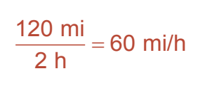

Slide 10
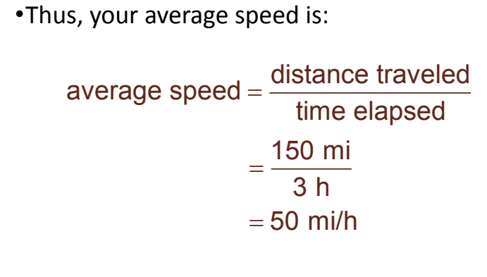

Slide 15
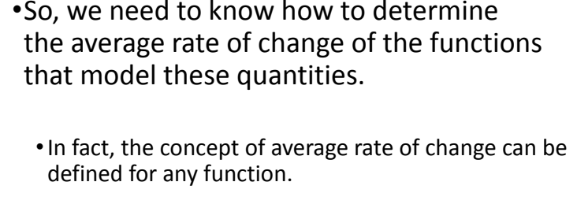

Slide 19
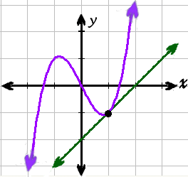
Tangent line to a curve
Definition: line that passes through a given point and has a slope that is the same as the slope of the curve at that point.

Slide 20
How can we find the slope of a tangent line?
Consider the graph of y = f(x) and a point (x, f(x)) and another point (x+h, f(x+h)). What would the slope of this line be?
We call this line a secant line. The line we are looking at right now is not very close to being a tangent line. Let’s make a closer secant line (let’s make h smaller).
(x+h, f(x+h))
(x+h, f(x+h))
(x, f(x))
h

Slide 21
Given the points (x, f(x)) and (x+h, f(x+h))..
As the secant line gets closer to being a tangent, slope approaches the slope of the tangent line.
As h → 0 the slope is undefined so we need to use limits to determine its value.
This limit is the DERIVATIVE of the function f(x)!

Slide 22
Other notations for derivatives:

Slide 23
Let’s try one..
$$\lim_{h→0}{\frac{f\left(x+h\right)−f(x)}{h}}$$
Everywhere you see an “x” replace it with “x+h”
Then subtract the original equation
Then divide by h
SIMPLIFY until you can sub in zero
Find the derivative using the formal definition:
f(x) = 2x

Slide 24
Find the derivative:
$$\lim_{h→0}{\frac{f\left(x+h\right)−f(x)}{h}}$$
Everywhere you see an “x” replace it with “x+h”
Then subtract the original equation
Then divide by h
SIMPLIFY until you can sub in zero
f(x) = x² + 3x – 1

